Slide 1
Design and Analysis of Algorithms
Introduction

Slide 2
Algorithm
An algorithm is a (finite) sequence of unambiguous instructions for solving a problem.
It has been the algorithm that has made possible the modern world
By David Berlinski, The Advent of the Algorithm, 2000
Algorithmics is more than a branch of computer science. It is the core of computer science, and, in all fairness, can be said to be relevant to most of science, business, and technology. [David Harel]

Slide 3
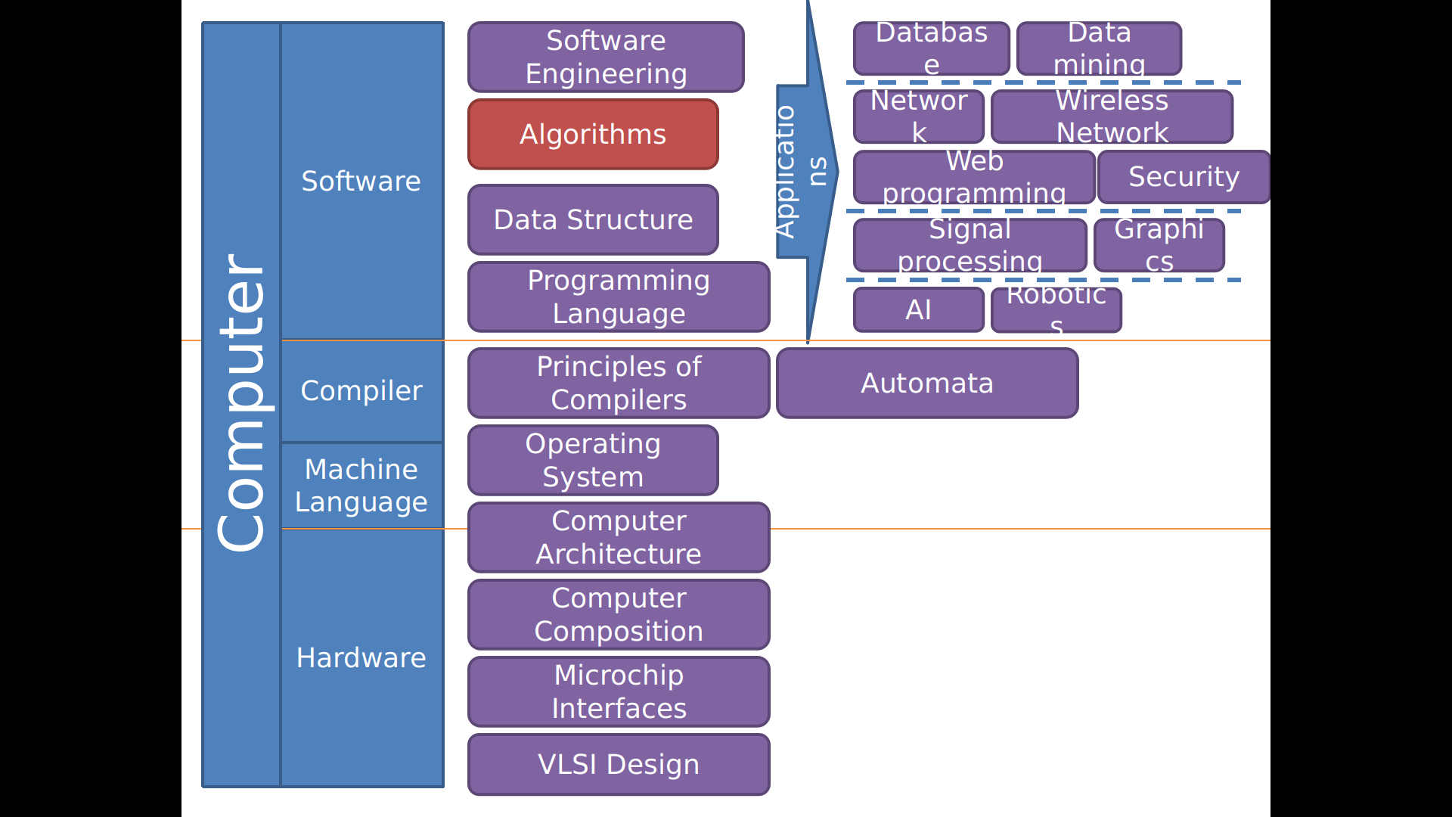

Slide 4

Algorithms
Analysis
Design
Algorithms for classic problems
Classic data structure
Sorting
Shortest path
Matrix multiplication
…
Asymptotic notations
Probabilistic analysis
Heap,
Hashing,
Binary Search Tree,
RBT,
….
Divide & Conquer
Greedy
Dynamic Programming
Quicksort,
Heapsort,
Mergesort,
…
…
…
…
$$O,Ω,Θ,...$$
…
…
…
…
…
…
…
…
…
…
…
…
…
…
…
…

Slide 5
CS302
Design and Analysis of Algorithms
Pre: Data Structures
Assignments / Quizzes | 15
Mid-Terms | 25 (12.5 each)
Project | 10
Final | 50

Slide 6
CLOs
Design algorithms using different algorithms design techniques i.e. Brute Force, Divide and Conquer, Dynamic Programming, Greedy Algorithms
Analyse the time and space complexity of different algorithms by using standard analysis techniques for recursive and non-recursive algorithms.
Discussion on Asymptotic notations, standard complexity classes and representation of time complexities in asymptotic notations of standard complexity functions
Describe, compare, analyse, and solve general algorithmic problem types: Sorting, Searching, String Processing, Graph.
Implement the algorithms, compare the implementations empirically, and apply fundamental algorithms knowledge to solve real-world problems.
Understanding of NP-Completeness and Approximate Problems.

Slide 7
Contents
Basics of Algorithms, Mathematical Foundation, Growth of Function, Asymptotic Notations.
Divide and Conquer, Substitution Method, Recurrence-Tree Method, Master’s Method.
Sorting (Merge, Insertion, Quick, Heap, Counting, Radix),Data Structures (Stack, Queue, Linked List, Hash Table, Binary Tree).
Dynamic Programming
Greedy Algorithms, Graph Theory (Graph Categorization, Graph Terminology, Representation of Graphs, BFS & DFS, Strongly Connected Components, Greedy Algorithms: Kruskal’s Algorithm, Prim’s Algorithms, Bellman-Ford Algorithms, Dijkstra’s Algorithm)
Geometric Algorithms (Introduction, Graham Scan, Close Points). String Matching
NP Complete Problems and Solutions using Approximation Algorithm

Slide 8
History of Algorithm
GCD by the Euclid (Ancient era)
Multiplication Arabic Numerals by Al-Khwarizmi (Muslim Golden era)
Robert of Chester (12th Century)
Multiplication Arabic Numerals by Fibnacci (12th Century)

Slide 9
Algorithm Analysis
What is an algorithm?
What are we interested in an algorithm?
How to measure an algorithm?
How to code divide-and-conquer algorithm?
Recursion
How to calculate the running time of divide-and-conquer algorithm?
Recurrence equation

Slide 10
What is an algorithm?
“a sequence of operations” (informal)
E.g.
The algorithm to walk
The algorithm to cook instant noodle
The algorithm to sort N integers

Slide 11
What is an algorithm?
Algorithm: walk to a destination
while (have not arrived at the destination)
{
put the back foot in front of the front foot;
}

Slide 12
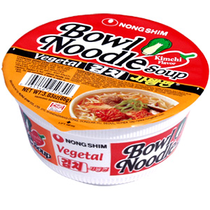
What is an algorithm?
Algorithm: cook a cup of instant noodles
Pull back lid to the dotted line.
Fill the cup to the inside line with boiling water from a kettle or from the microwave
Close lid and let stand for 3 minutes.
Stir well and add a pinch of salt and pepper to taste.

Slide 13
What are we interested in an algorithm?
Correctness
Efficiency
Time complexity – measure the execution time?
Space complexity

Slide 14
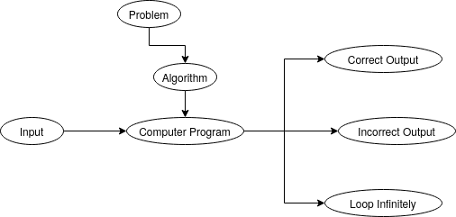
Correct Algorithm
An algorithm is said to be correct if, for every input instance, it halts with the correct output.

Slide 15
How to measure an algorithm?
The number of key operations
The number of space units needed
What if the input is uncertain?

Slide 16
How to measure an algorithm?
E.g. Search a book in a box of books
Key operation: check the title of a book
Space unit: the space for one book

Slide 17
Why?
Theoretical Reasons
To prove the requirements of a project.
Practice Reasons
Analysis of human DNA 100,000 genes
Relevant Information from internet (google)
Adaptability (Facebook over Myspace)
News analysis by machine
Cryptography and digital signatures
Optimal resource allocation for a firm

Slide 18
Algorithm
Algorithm SumOfSquares
INPUT: a; b; where a and b are integers
OUTPUT: c; where c is a sum of the squares of input numbers.
start;
c := a*a + b*b;
return c;
end;

Slide 19
Bubble Sort
procedure bubbleSort(A : list of sortable items)
n := length(A)
repeat
swapped := false
for i := 1 to n-1 inclusive do
if A[i-1] ≥ A[i] then
swap(A[i-1], A[i])
swapped := true
end if
end for
until not swapped
end procedure

Slide 20
Algorithmic Problem Solving
Trivial Approach
Algorithmic Approach
Analyze the algorithm
Design a program
Implement the program
Execute the code
Measure the time
See if the solution is ok
End The procedure
Analyze the algorithm
Methods of Specifying an Algorithm
Proving an Algorithm’s Correctness
See if the solution is ok
Coding an Algorithm
End The procedure

Slide 21
Multiplication of Arabic Numerals
Among many other contributions in mathematics, astronomy, and geography, he wrote a book about how to multiply with Arabic numerals.

Slide 22
Multiplication
1234567890
X 4578963210
10*10=100 single digit multiplications

Slide 23
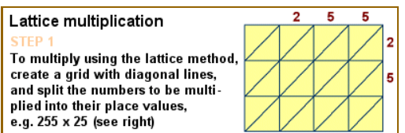
Multiplication of Arabic Numerals

Slide 24
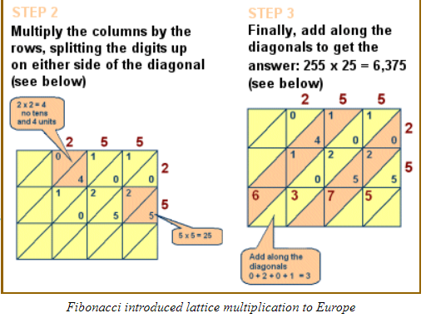
Multiplication of Arabic Numerals

Slide 25
Design and Analysis of Algorithms
Analysis of Algorithms

Slide 26
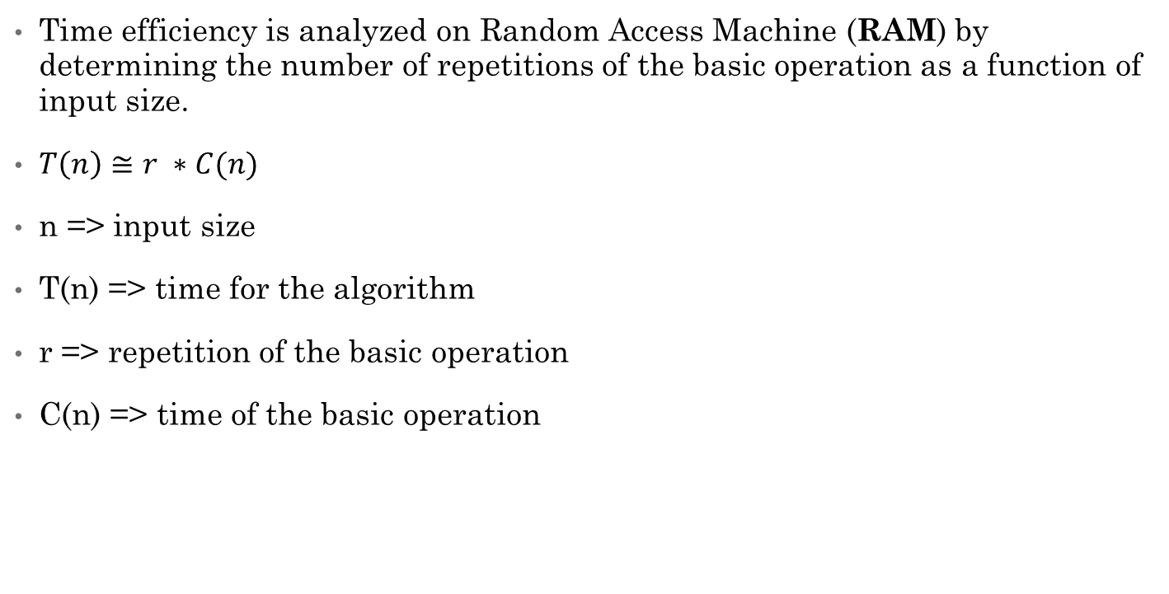
Analysis of Algorithms
Time efficiency is analyzed on Random Access Machine (RAM) by determining the number of repetitions of the basic operation as a function of input size.
$T\left(n\right)≅r ∗C(n)$
n => input size
T(n) => time for the algorithm
r => repetition of the basic operation
C(n) => time of the basic operation

Slide 27
How do we write algorithms?
Pseudo Code:
Similar construct / keywords as in a high level programming languages, e.g. in C, Pascal etc.
Structured semantics of the high level languages without caring about the syntactic errors / grammatical rules

Slide 28
Analysis
What are the constructs / Keywords.
Time for each construct
Total Time
Total time as a function of input size

Slide 29
Constructs
Sequence Statements
Just add the running time of the statements (int x, x=5, x++, y-=x etc.)
Selection
Add the time of maximum conditional code (if else, switch).
Iteration is at most the running time of the statements inside the loop (including tests) times the number of iterations.

Slide 30
Constructs
If-Then-Else:
if (condition) S₁ else S₂
Running time of the test plus the larger of the running times of S₁ and S₂.
Nested Loops: Analyze these inside out. The total Running time of a statement inside a group of nested loops is the running time of the statement multiplied by the product of the size of all the loops.
Function Calls: Analyzing from inside to out. If there are function calls, these must be analyzed first.

Slide 31
Sequence Statements
int x=0
Y=x+1
Z=12

Slide 32
Selection
if(i==2)
//2 statements
else
//5 statements

Slide 33
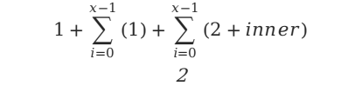
Iteration
for (i=0;i<x;i++)
[2 statements]
$$1+\sum_{i=0}^{x−1}{(1)+\sum_{i=0}^{x−1}{(2+inner)}}$$
2

Slide 34
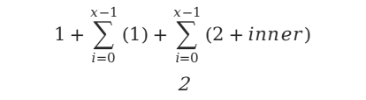
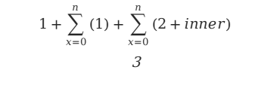
Iteration
for (x=n;x=0;x--)
[3 statements]
$$1+\sum_{x=0}^{n}{(1)+\sum_{x=0}^{n}{(2+inner)}}$$
3
for (i=0;i<x;i++)
[2 statements]
$$1+\sum_{i=0}^{x−1}{(1)+\sum_{i=0}^{x−1}{(2+inner)}}$$
2

Slide 35
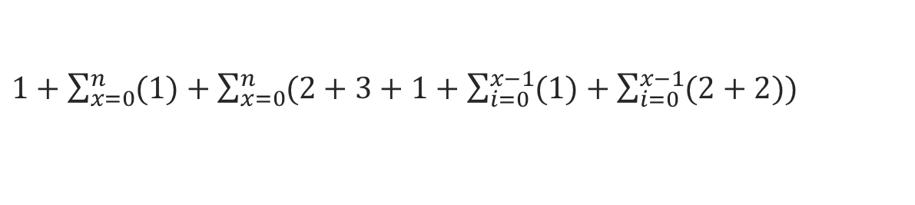
Iteration
for (x=n;x=0;x--)
[3 statements]
$$1+\sum_{x=0}^{n}{(1)+\sum_{x=0}^{n}{(2+inner)}}$$
3
for (i=0;i<x;i++)
[2 statements]
$$1+\sum_{i=0}^{x−1}{(1)+\sum_{i=0}^{x−1}{(2+inner)}}$$
2
$1+\sum_{x=0}^{n}{(1)+\sum_{x=0}^{n}{(2+3+1+\sum_{i=0}^{x−1}{(1)+\sum_{i=0}^{x−1}{(2+2)}})}}$

Slide 36
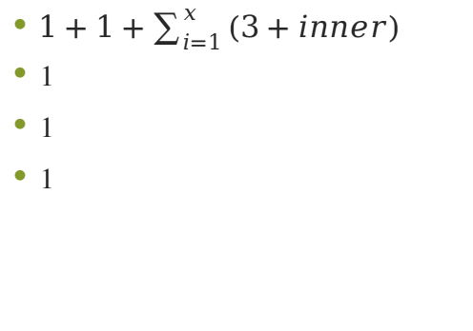
Palindrom
palindrom(s,x) {
for(i=x,j=1;i>=1;i--,j++)
if(s[i]!=s[j])
return false;
return true;
}
$1+1+\sum_{i=1}^{x}{(3+inner)}$
1
1
1

Slide 37
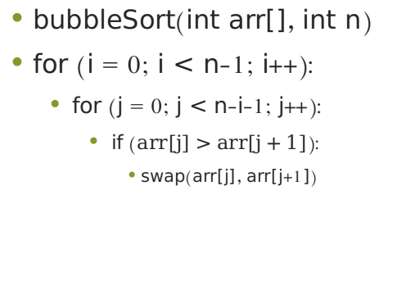
Sorting Algorithm
bubbleSort(int arr[], int n)
for (i = 0; i < n-1; i++):
for (j = 0; j < n-i-1; j++):
if ($arr[j]>arr[j+1]$):
swap(arr[j], arr[j+1])

Slide 38
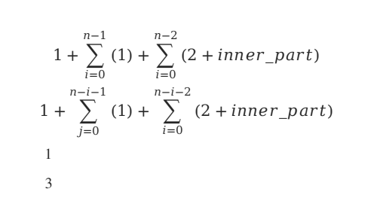
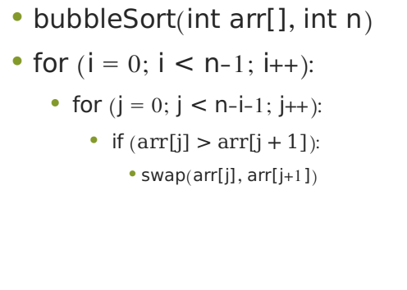
Sorting Algorithm
bubbleSort(int arr[], int n)
for (i = 0; i < n-1; i++):
for (j = 0; j < n-i-1; j++):
if ($arr[j]>arr[j+1]$):
swap(arr[j], arr[j+1])
$$1+\sum_{i=0}^{n−1}{(1)}+\sum_{i=0}^{n−2}{(2+inner_part)}$$
$$1+\sum_{j=0}^{n−i−1}{(1)}+\sum_{i=0}^{n−i−2}{(2+inner_part)}$$
1
3

Slide 39
Sorting Algorithm
bubbleSort(int arr[], int n)
for (i = 0; i < n-1; i++):
for (j = 0; j < n-i-1; j++):
if ($arr[j]>arr[j+1]$):
swap(arr[j], arr[j+1])
$$1+\sum_{i=0}^{n−1}{(1)}+\sum_{i=0}^{n−2}{(2+inner_part)}$$
$$1+\sum_{j=0}^{n−i−1}{(1)}+\sum_{i=0}^{n−i−2}{(2+inner_part)}$$
1
3
$1+\sum_{i=0}^{n−1}{(1)}+\sum_{i=0}^{n−2}{(2+1+\sum_{j=0}^{n−i−1}{(1)}+\sum_{i=0}^{n−i−2}{(2+4)})}$

Slide 40
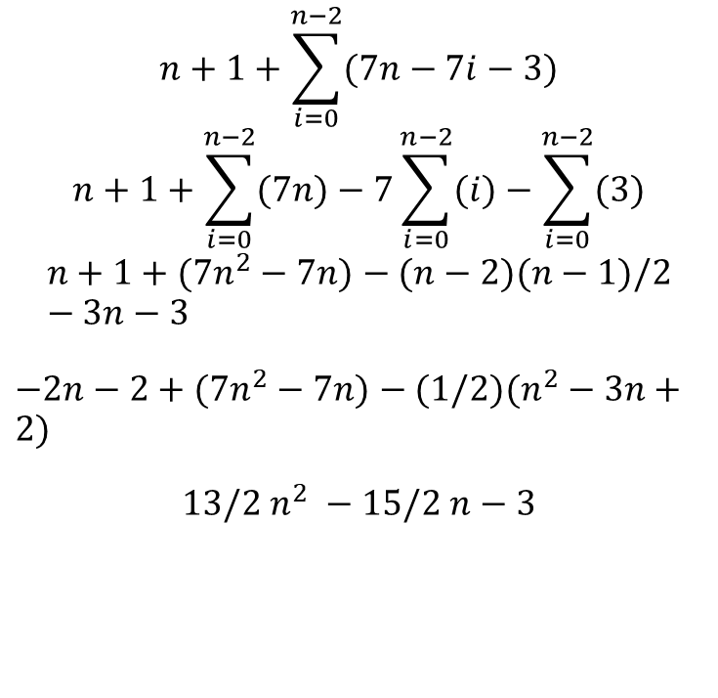
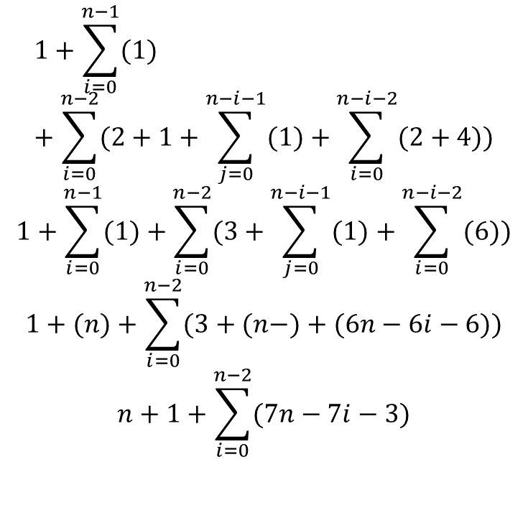
Sorting Algorithm
$$1+\sum_{i=0}^{n−1}{(1)}+\sum_{i=0}^{n−2}{(2+1+\sum_{j=0}^{n−i−1}{(1)}+\sum_{i=0}^{n−i−2}{(2+4)})}$$
$$1+\sum_{i=0}^{n−1}{(1)}+\sum_{i=0}^{n−2}{(3+\sum_{j=0}^{n−i−1}{(1)}+\sum_{i=0}^{n−i−2}{(6)})}$$
$$1+(n)+\sum_{i=0}^{n−2}{(3+(n−���)+(6n−6i−6))}$$
$$n+1+\sum_{i=0}^{n−2}{(7n−7i−3)}$$
$$n+1+\sum_{i=0}^{n−2}{(7n−7i−3)}$$
$$n+1+\sum_{i=0}^{n−2}{(7n)}−7\sum_{i=0}^{n−2}{(i)}−\sum_{i=0}^{n−2}{(3)}$$
$$n+1+(7n^{2}−7n)−(n−2)(n−1)/2−3n−3$$
$−2n−2+(7n^{2}−7n)−(1/2)(n^{2}−3n+2)$
$13/2 n^{2} −15/2 n−3$

Slide 41
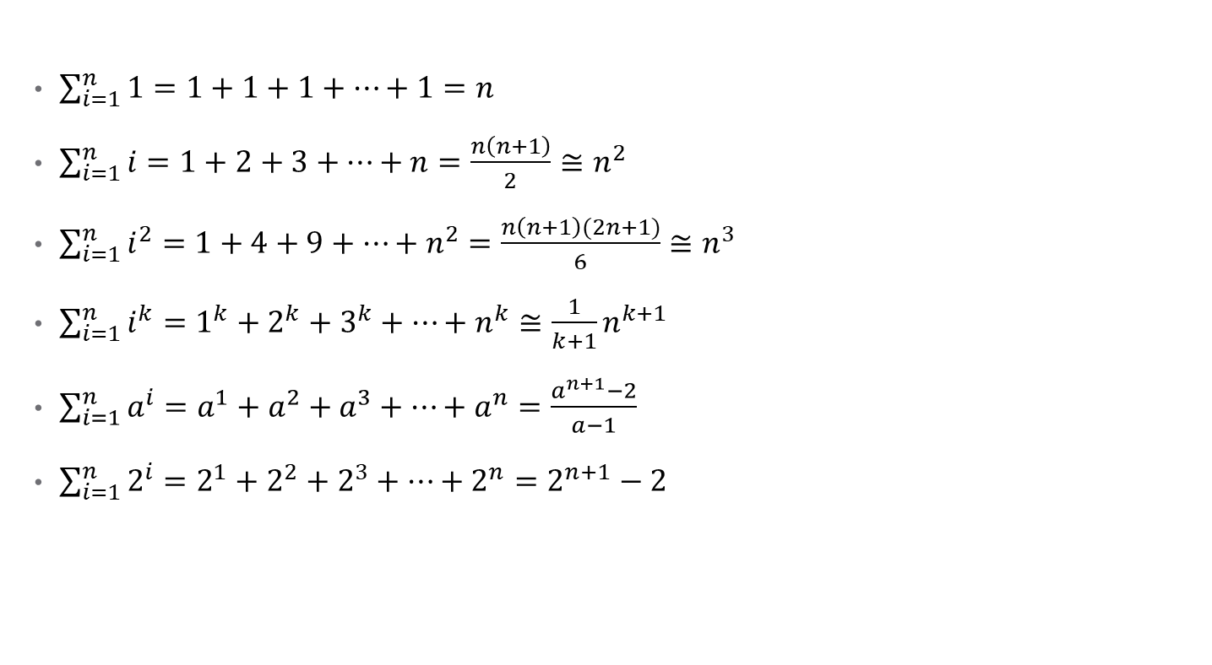
Mathematical Formula
$\sum_{i=1}^{n}{1}=1+1+1+…+1=n$
$\sum_{i=1}^{n}{i}=1+2+3+…+n=\frac{n\left(n+1\right)}{2}≅n^{2}$
$\sum_{i=1}^{n}{i^{2}}=1+4+9+…+n^{2}=\frac{n\left(n+1\right)(2n+1)}{6}≅n^{3}$
$\sum_{i=1}^{n}{i^{k}}=1^{k}+2^{k}+3^{k}+…+n^{k}≅{\frac{1}{k+1}n}^{k+1}$
$\sum_{i=1}^{n}{a^{i}}=a^{1}+a^{2}+a^{3}+…+a^{n}=\frac{a^{n+1}−2}{a−1}$
$\sum_{i=1}^{n}{2^{i}}=2^{1}+2^{2}+2^{3}+…+2^{n}=2^{n+1}−2$

